Slide 1
9

Slide 2
9

Slide 3
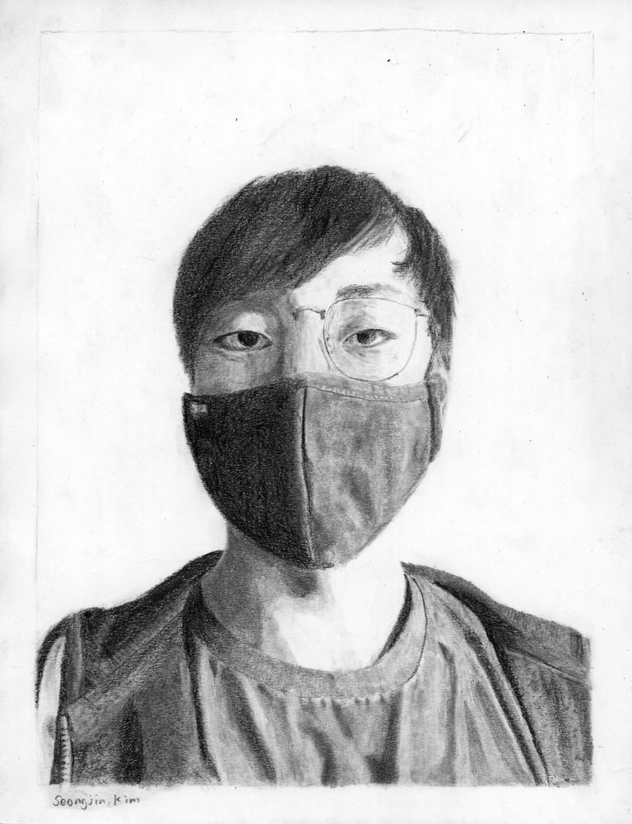
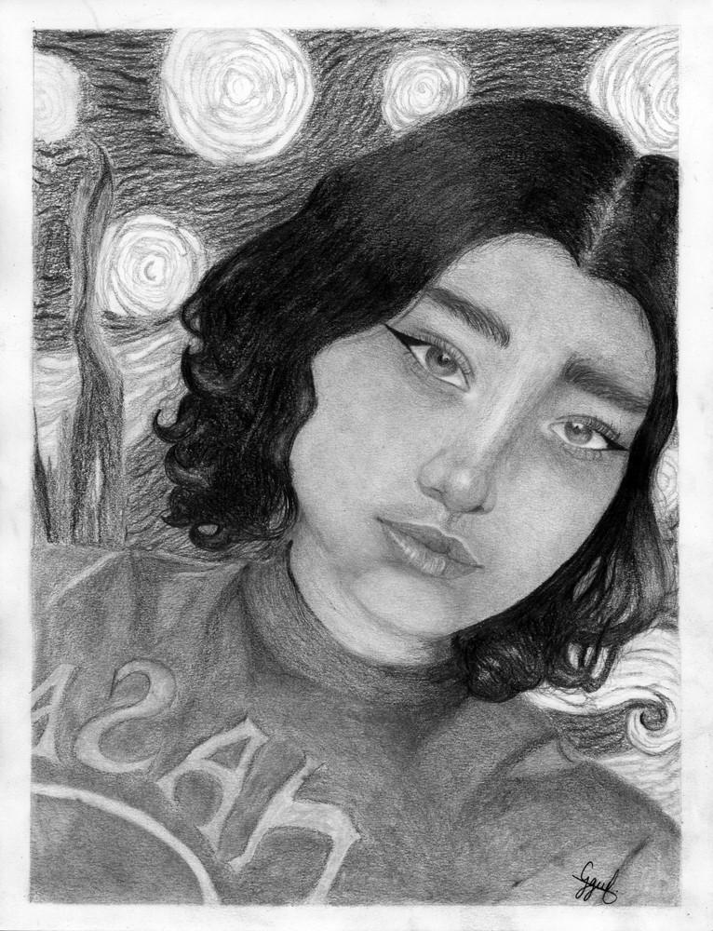
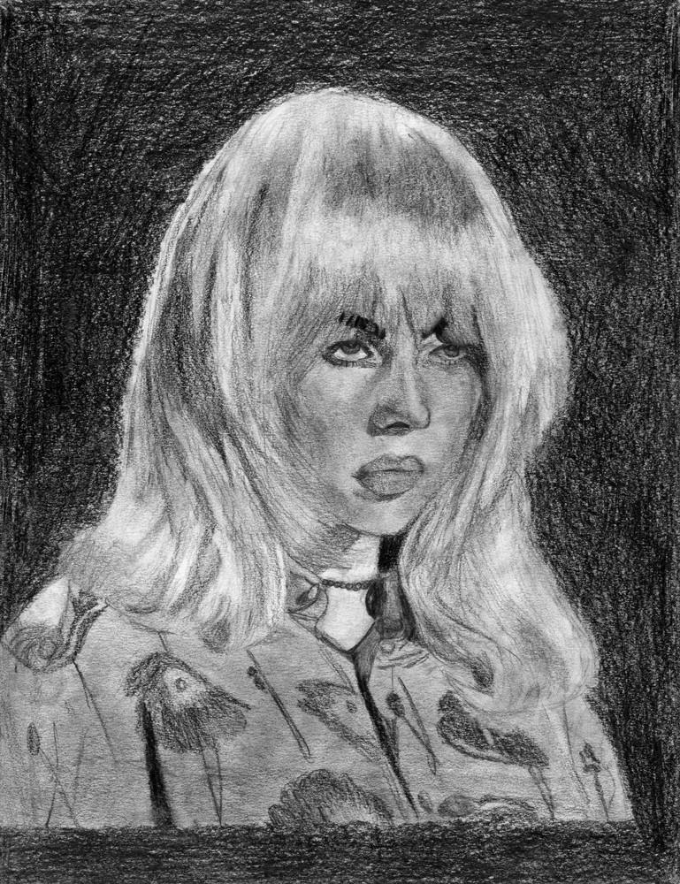
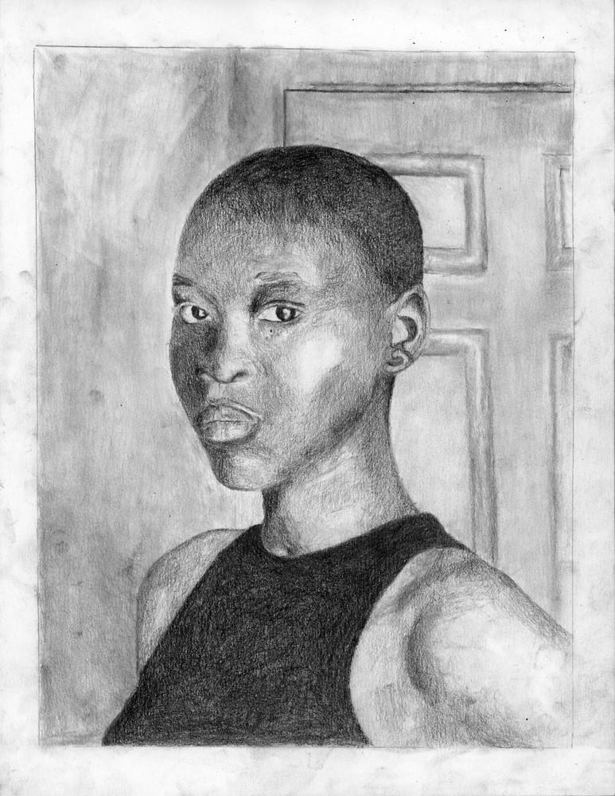
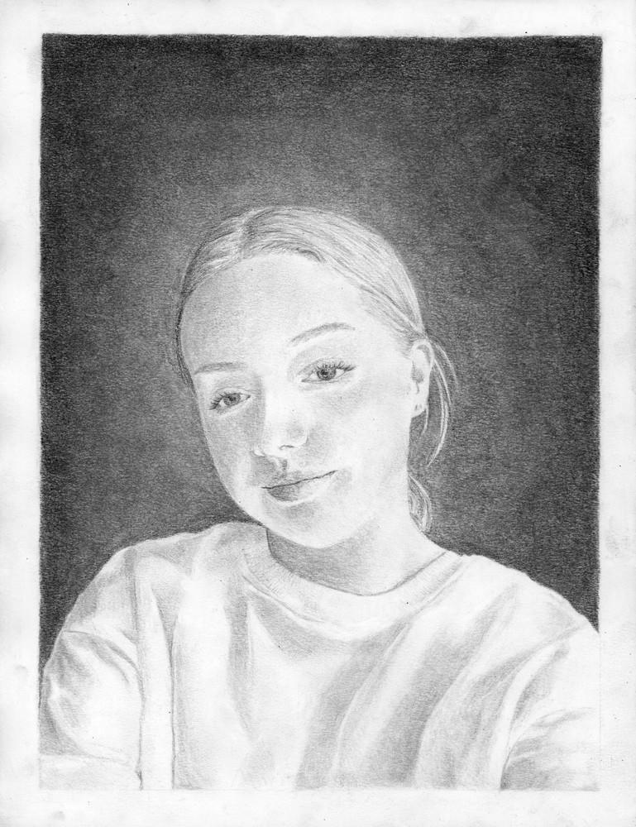
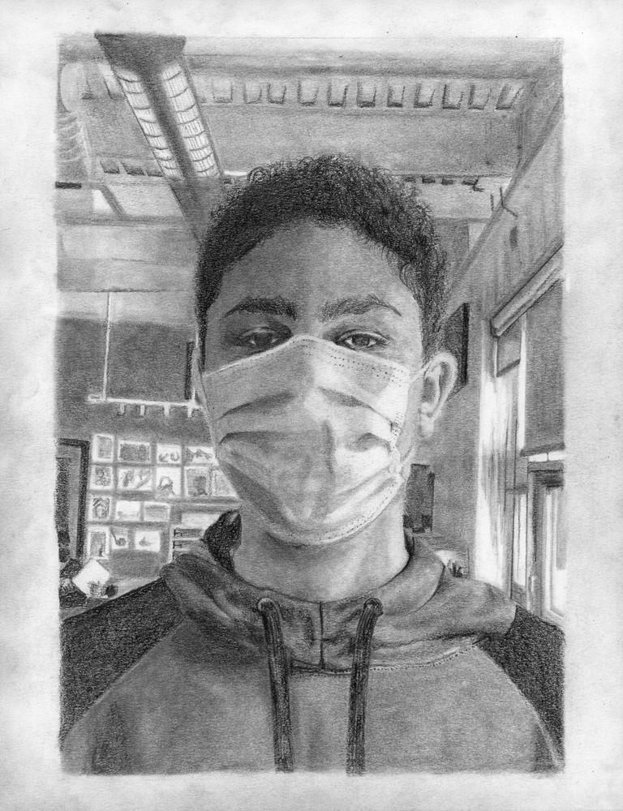
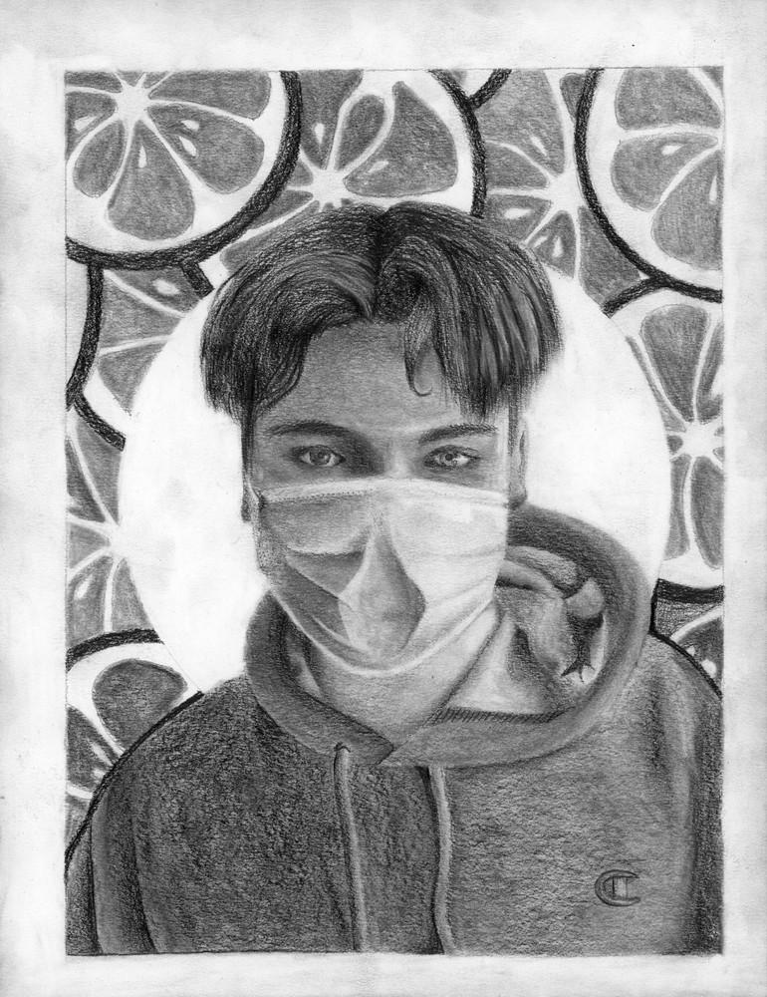
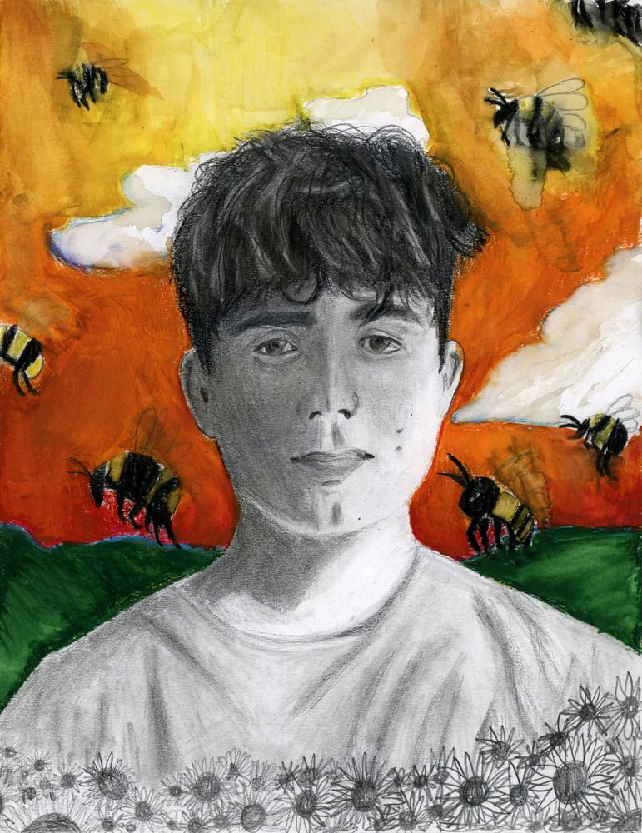
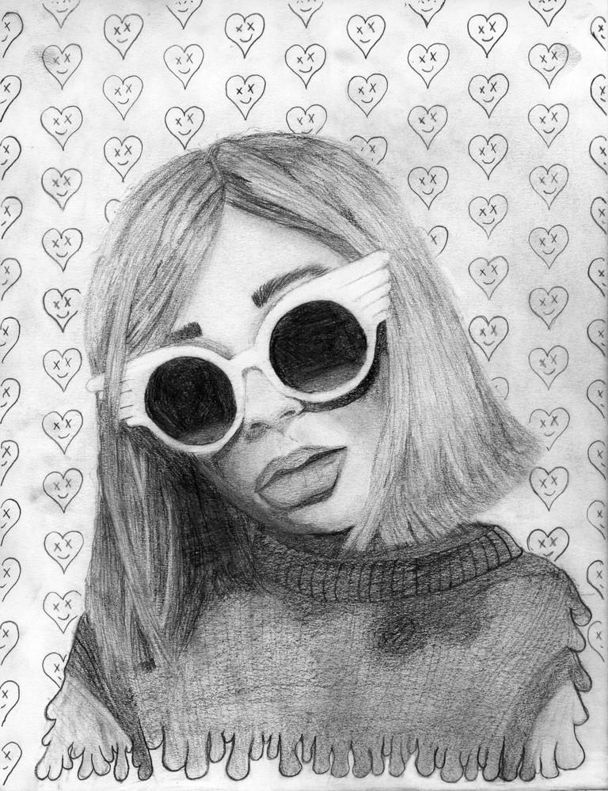

Slide 4
Seongjin Kim
graphite on paper
Fall 2021

Slide 5
Grote Rodriguez
graphite on paper
Fall 2021

Slide 6
Sophia Hewitt
graphite on paper
Fall 2021

Slide 7
Ajulu Omod
graphite on paper
Fall 2021

Slide 8
Maeve Brown
graphite on paper
Fall 2021

Slide 9
Bishir Green
graphite on paper
Fall 2021

Slide 10
Ryan Bezanson
graphite on paper
Fall 2021

Slide 11
Avery Myette
graphite and watercolour pencil on paper
Fall 2021

Slide 12
Jacob Trahon
graphite on paper
Fall 2021

Slide 14
10

Slide 15
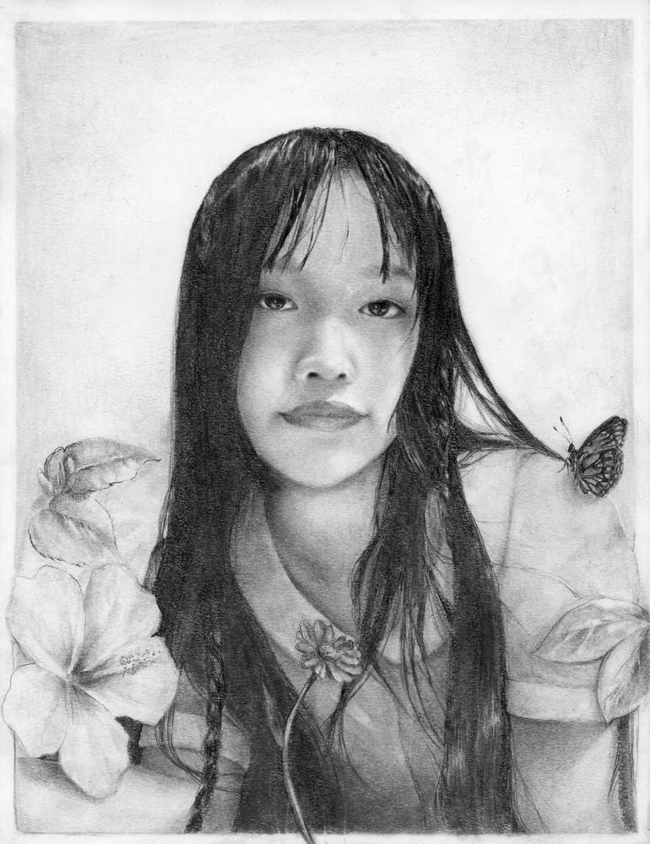
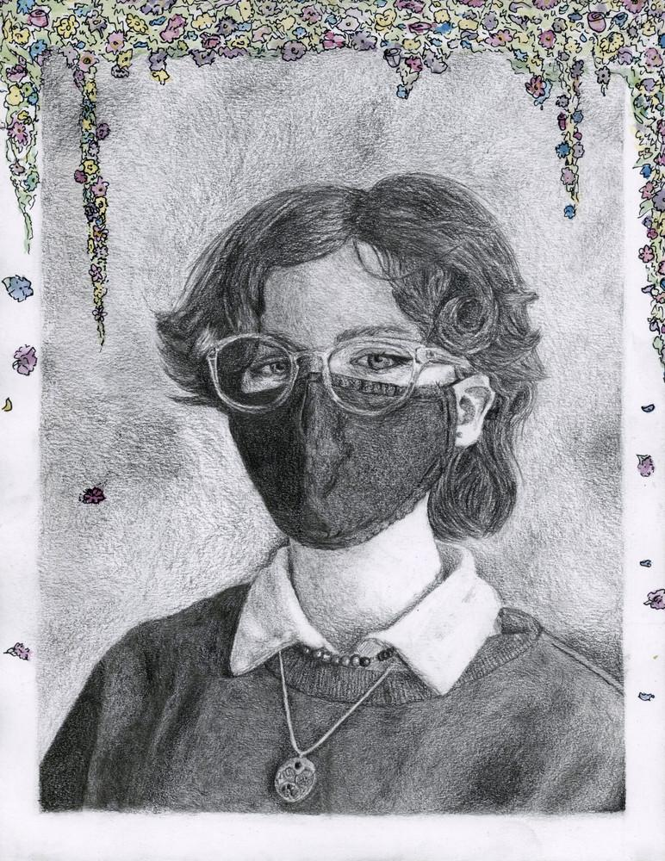
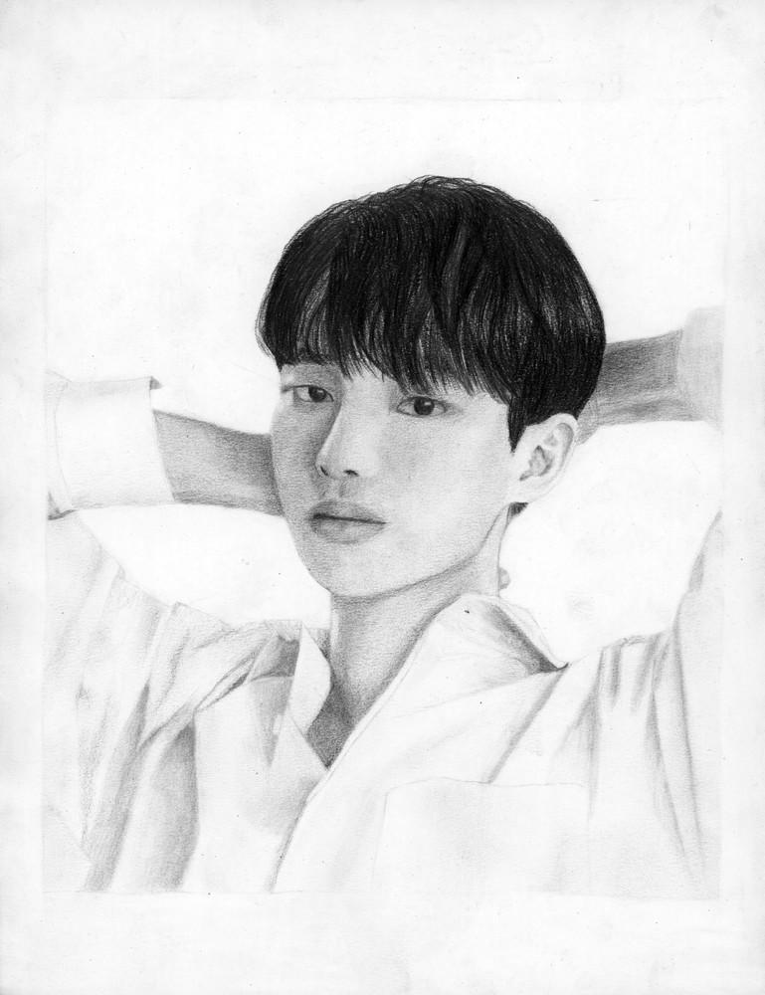
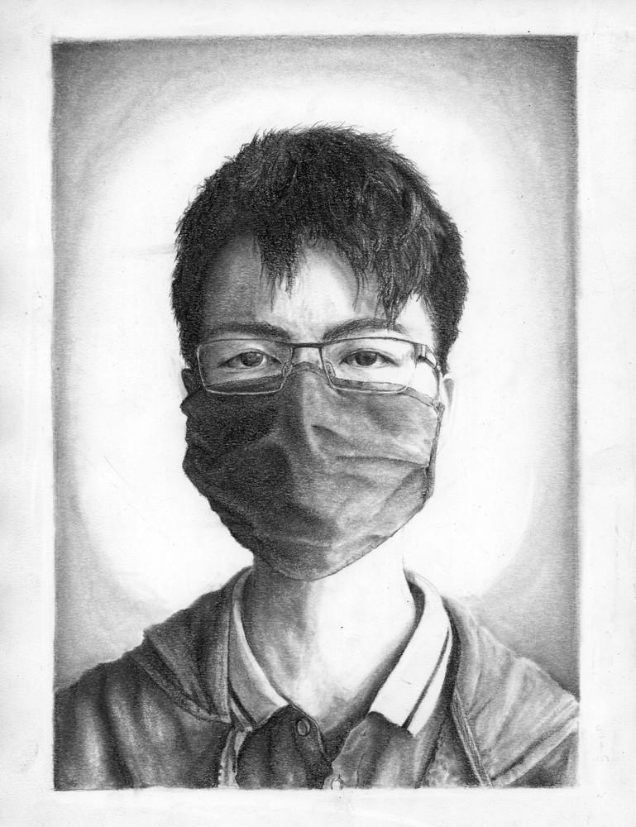
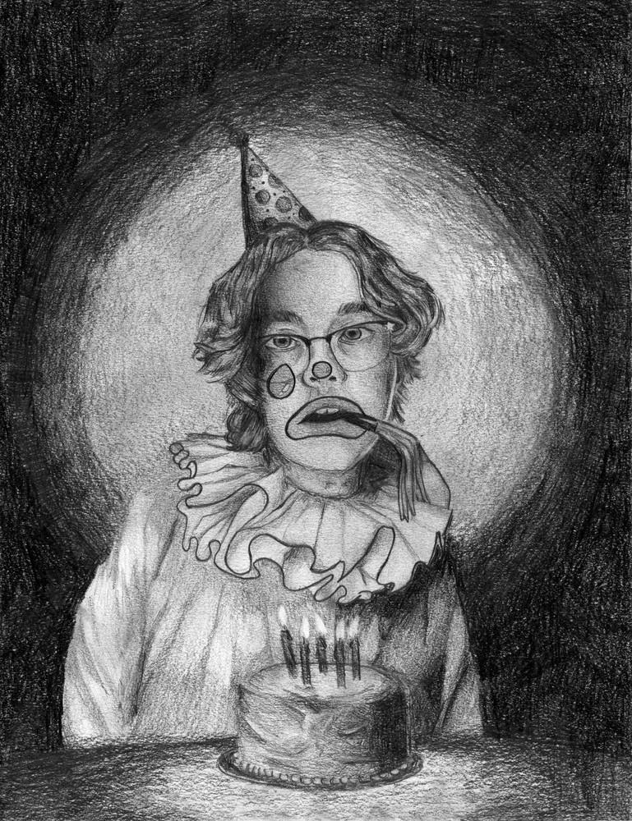
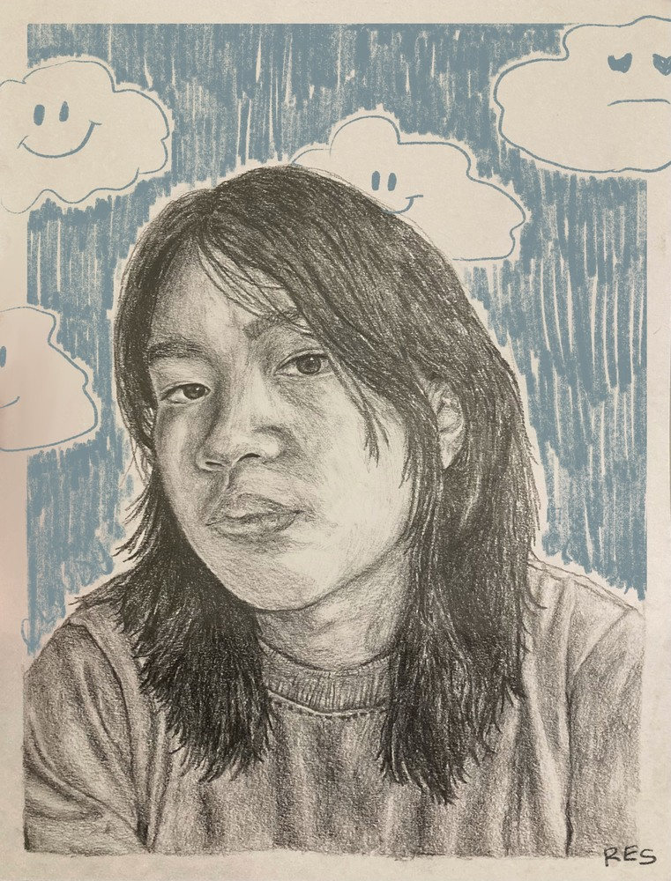
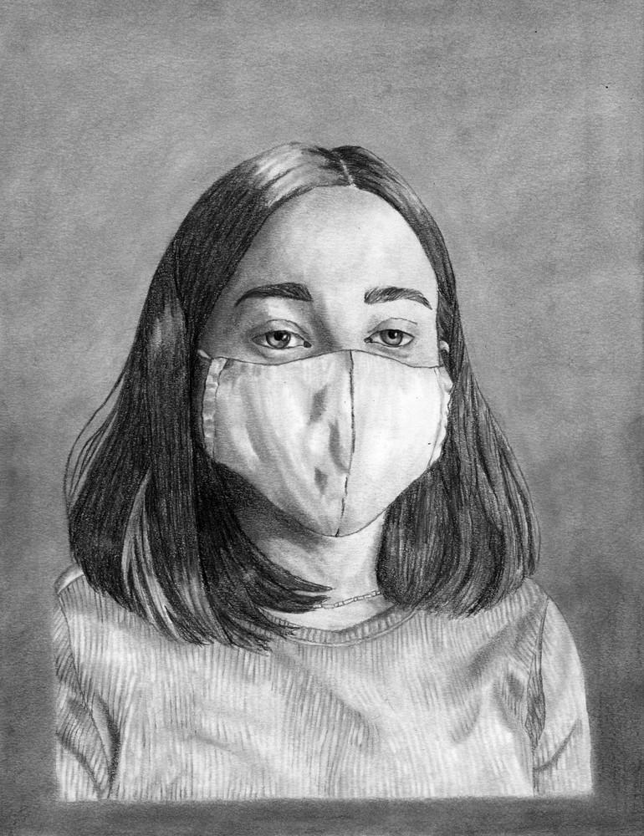
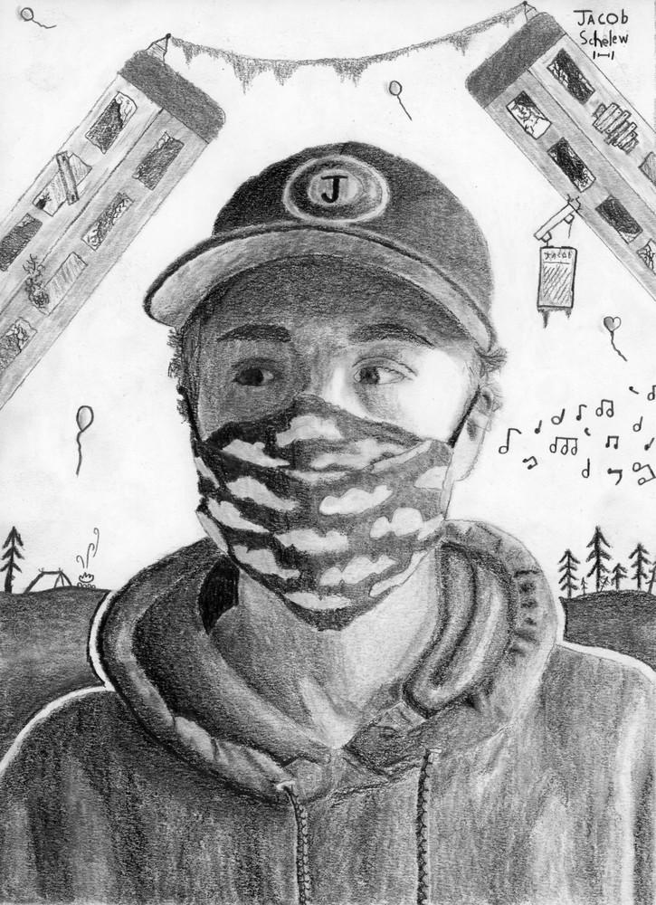
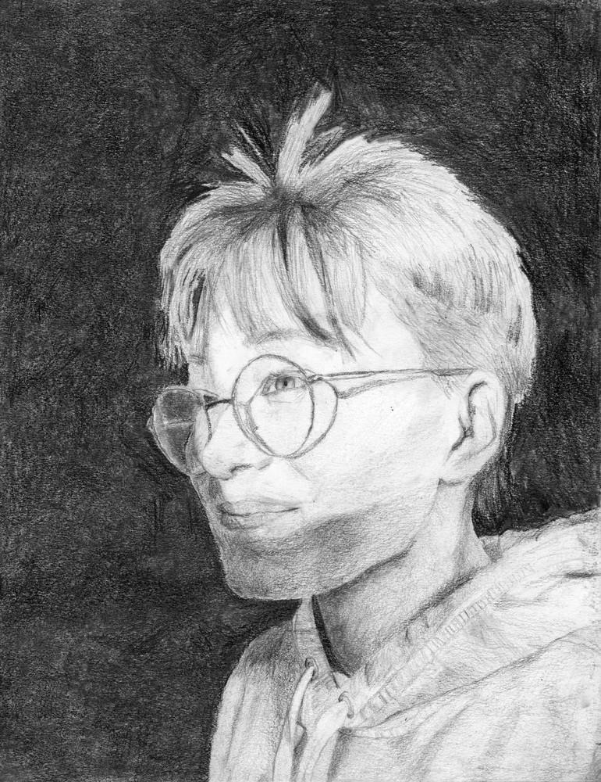
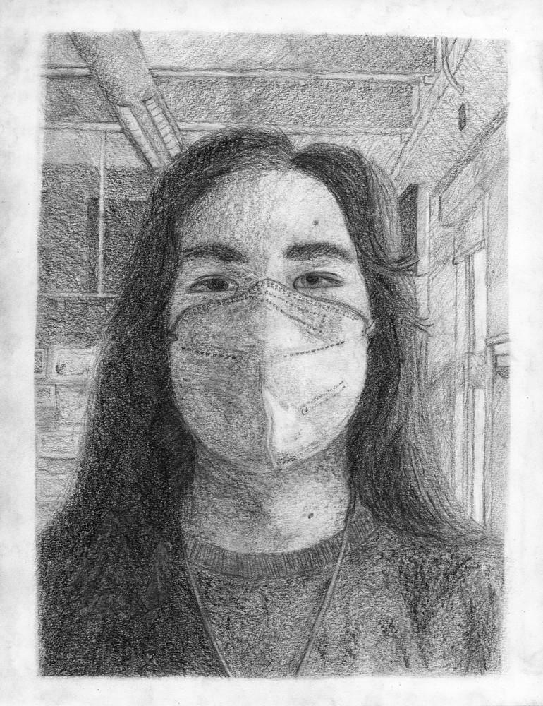

Slide 16
Rovinne Tiamson
graphite on paper
Fall 2021

Slide 17
Elgin Wilson
graphite, ink, and watercolour on paper
Fall 2021

Slide 18
Yejun Myoung
graphite on paper
Fall 2021

Slide 19
Andrew Santiago
graphite on paper
Fall 2021

Slide 20
Hugh Sullivan
graphite on paper
Fall 2021

Slide 21
Reese Villanueva
graphite and coloured pencil on paper
Fall 2021

Slide 22
Kylee Wright
graphite on paper
Fall 2021

Slide 23
Jacob Schelew
graphite on paper
Fall 2021

Slide 24
Marina Van Wart
graphite on paper
Fall 2021

Slide 25
Nate Chin
graphite on paper
Fall 2021

Slide 27
11

Slide 28
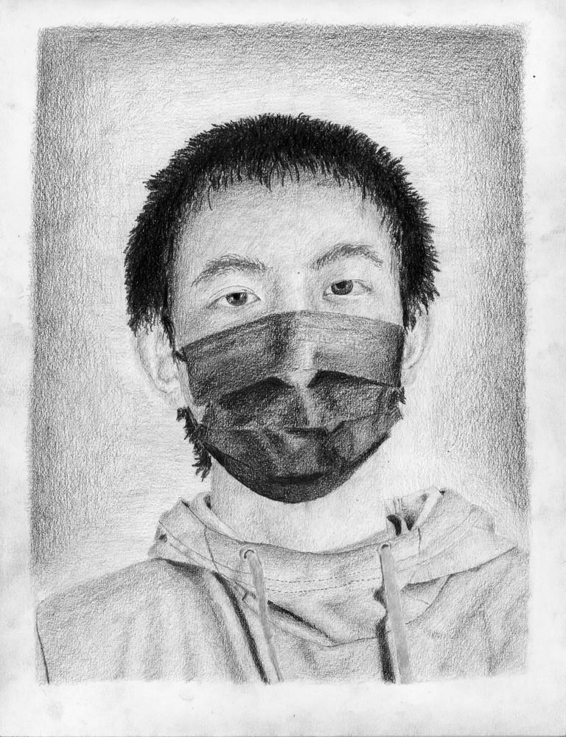
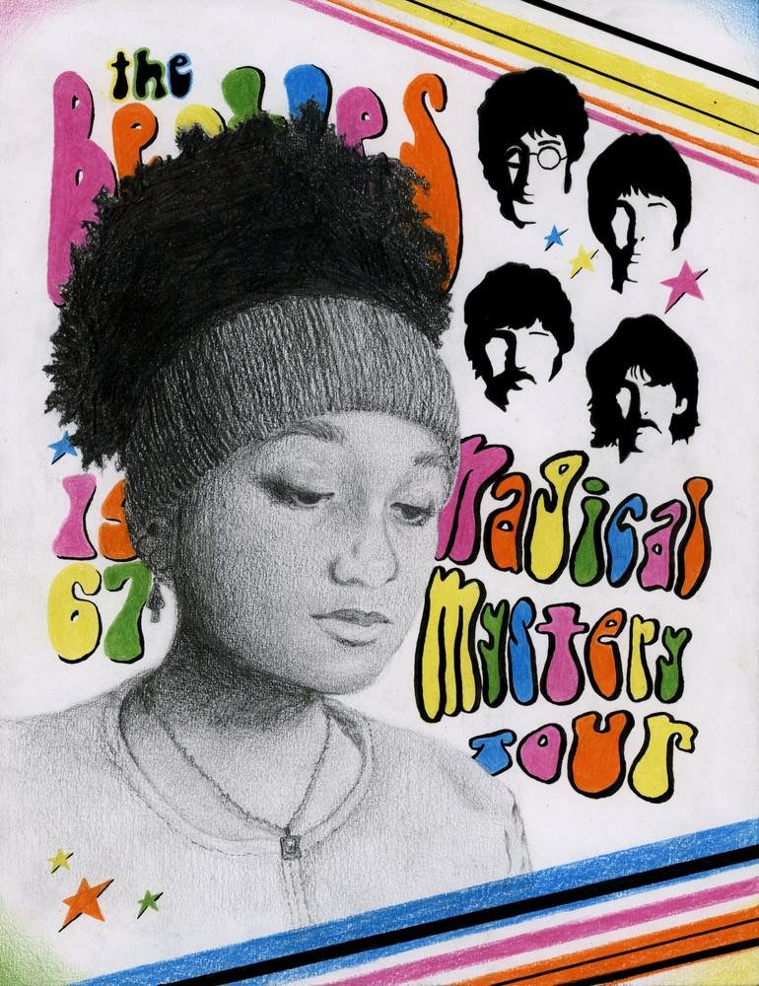
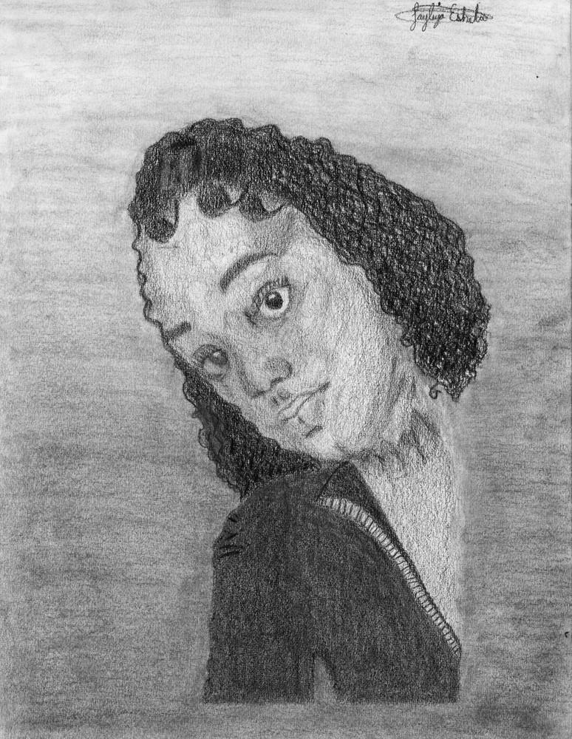
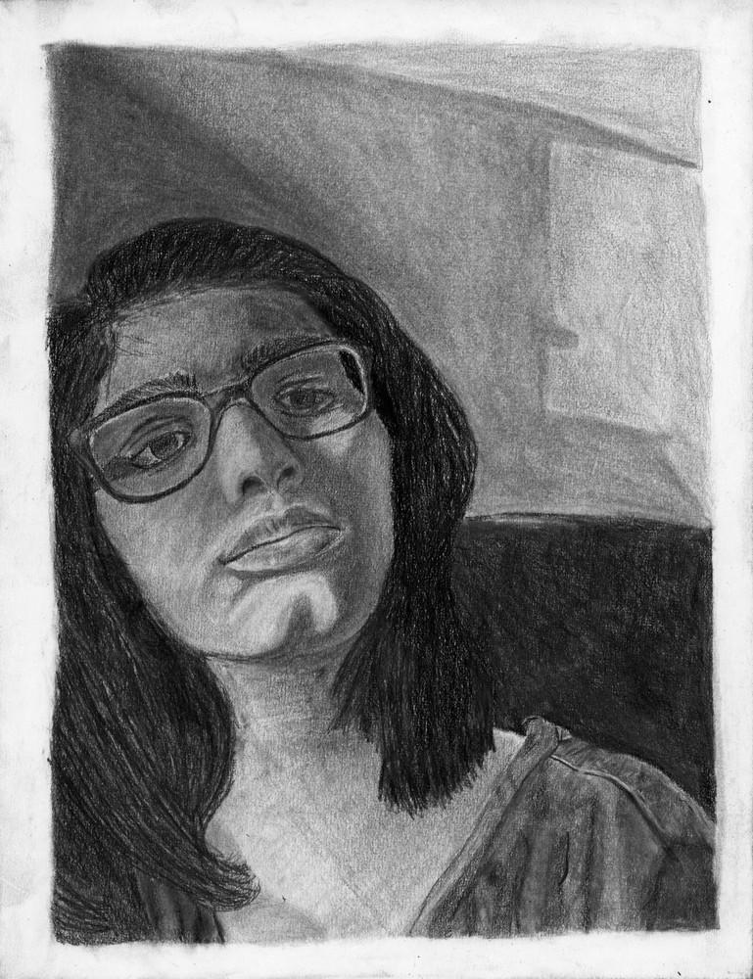
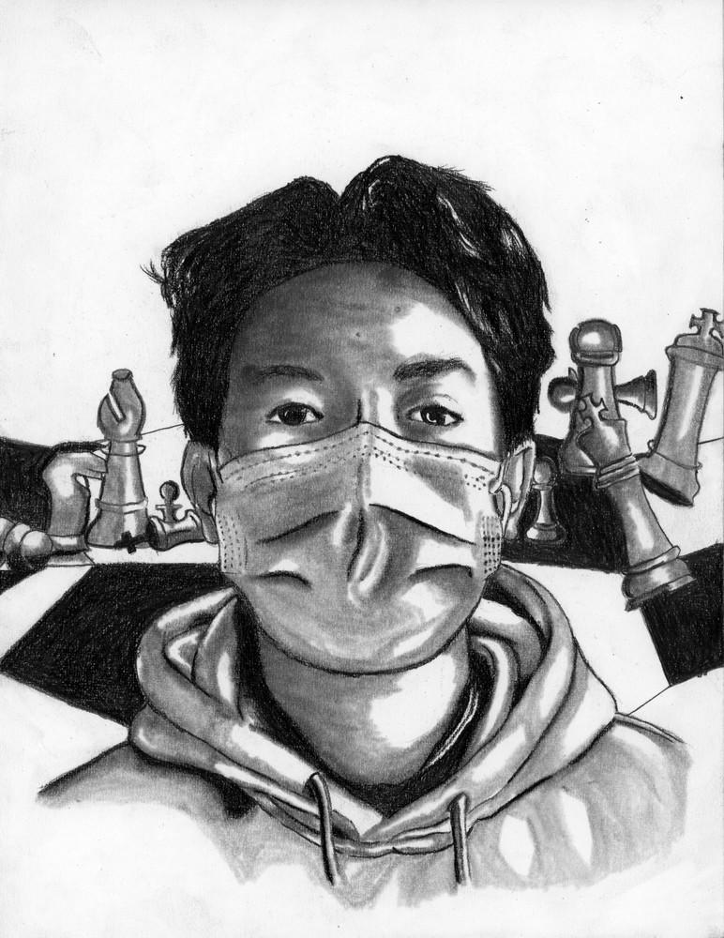
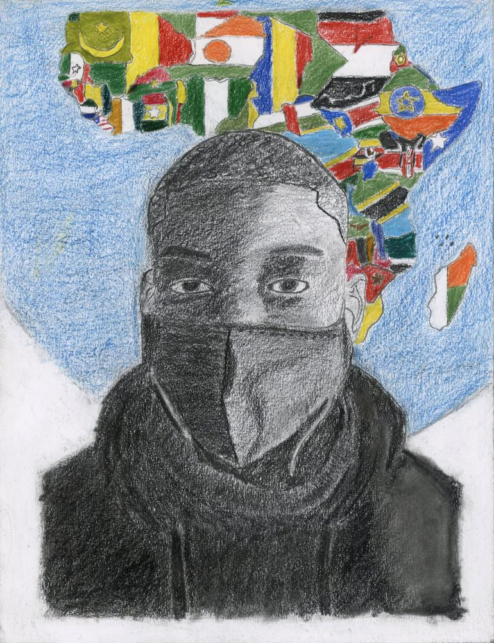
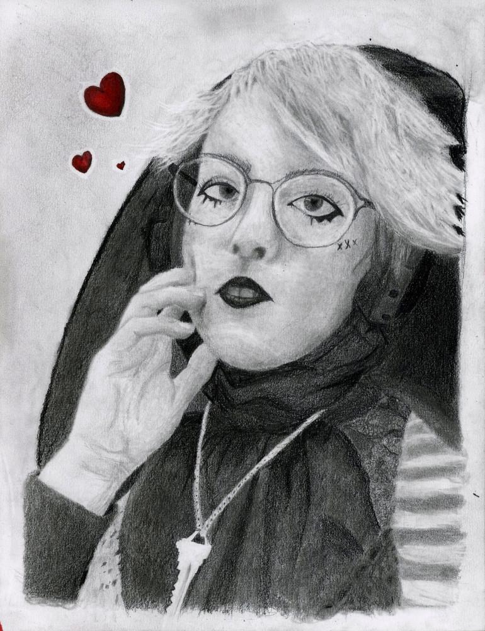
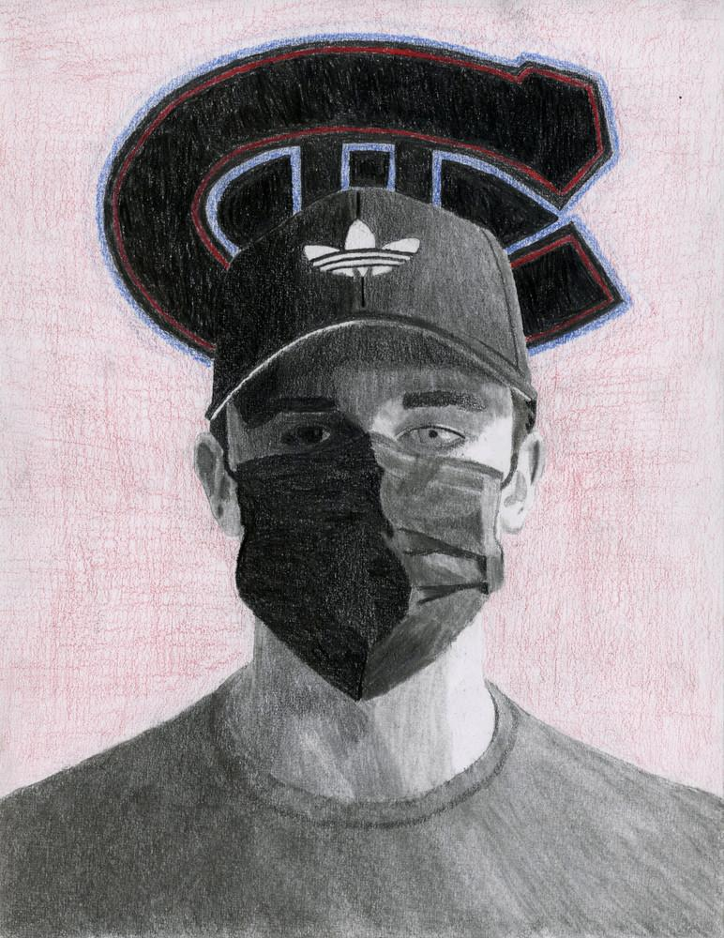
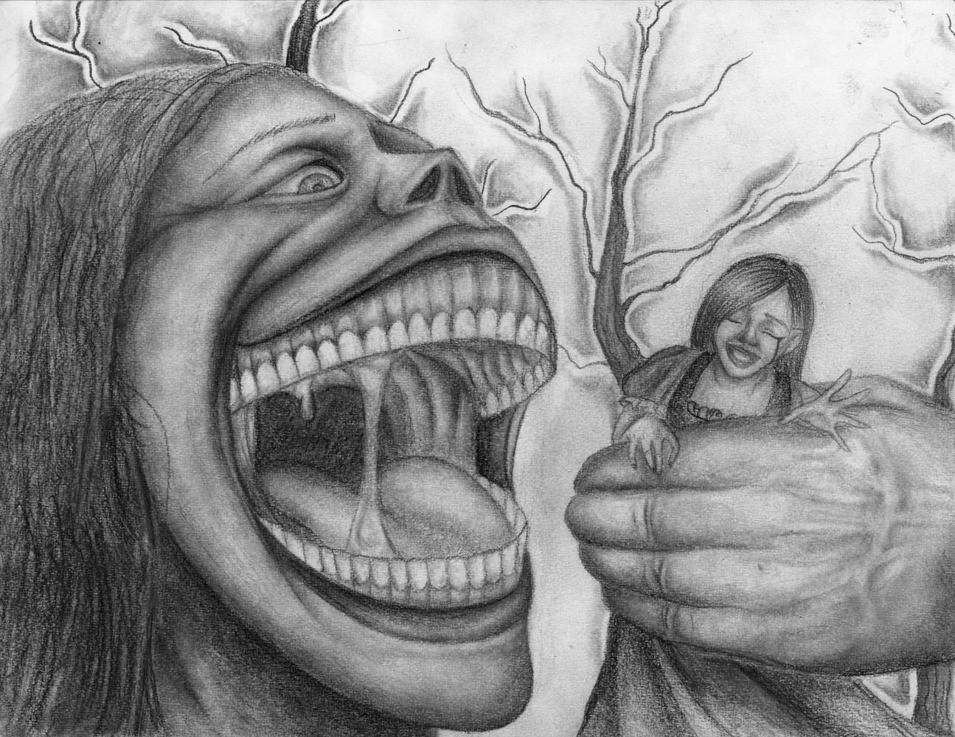
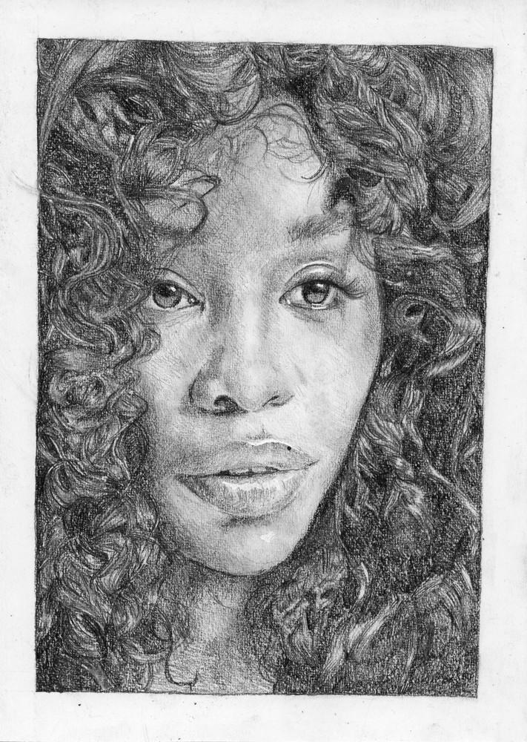

Slide 29
Zhihao Di
graphite on paper
Spring 2022

Slide 30
Wangari Mathenge
graphite and coloured pencil on paper
Spring 2022

Slide 31
Tia Eshetu
graphite on paper
Spring 2022

Slide 32
Simone Singh
graphite on paper
Spring 2022

Slide 33
Airon Miko Ortega
graphite on paper
Spring 2022

Slide 34
Amebe Ngei
graphite on paper
Spring 2022

Slide 35
Aron Campbell
graphite on paper
Spring 2022

Slide 36
Brennan Murphy
graphite on paper
Spring 2022

Slide 37
Jo Scanlan-Casey, graphite on paper, Spring 2022

Slide 38
Deborah Belachew
graphite on paper
Spring 2022

Slide 40
12

Slide 41
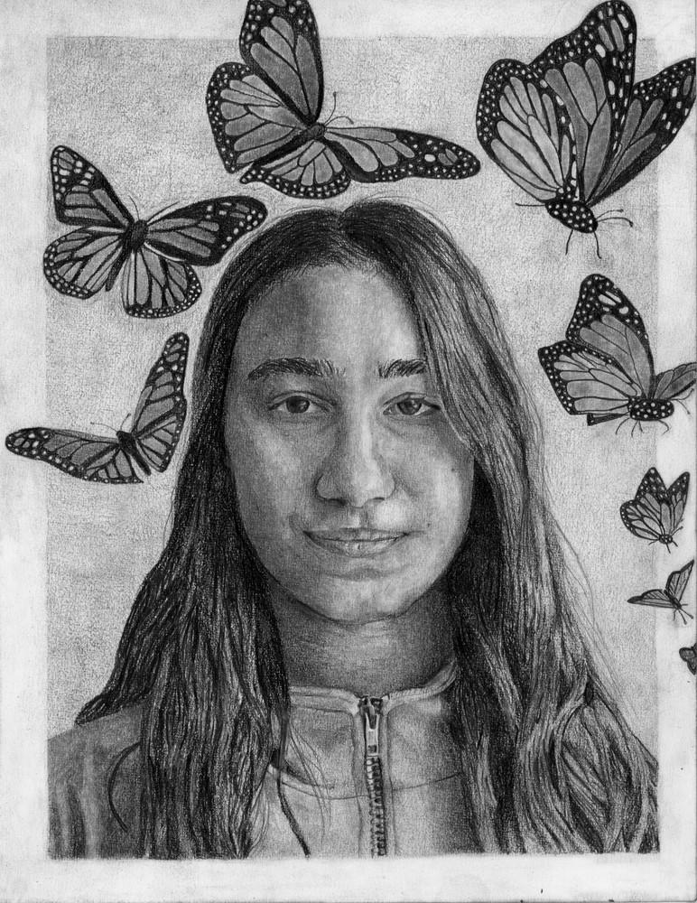
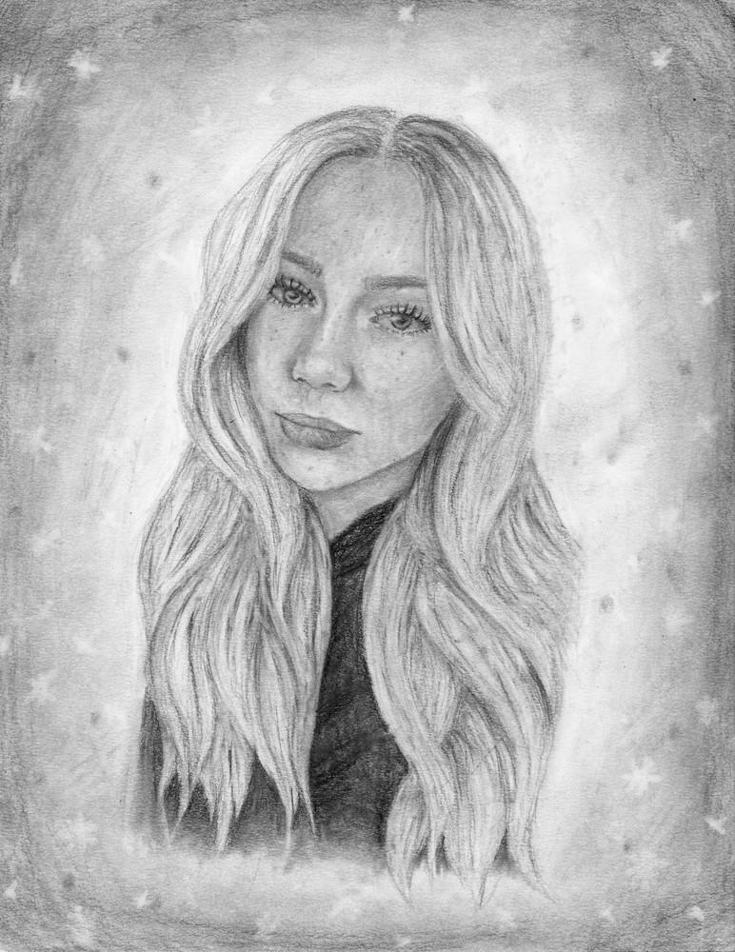
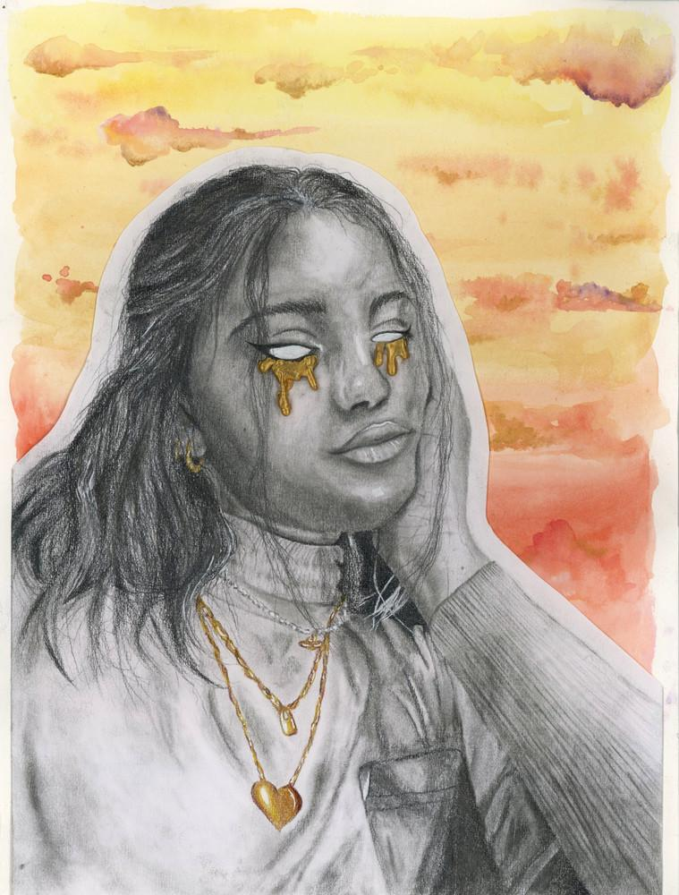
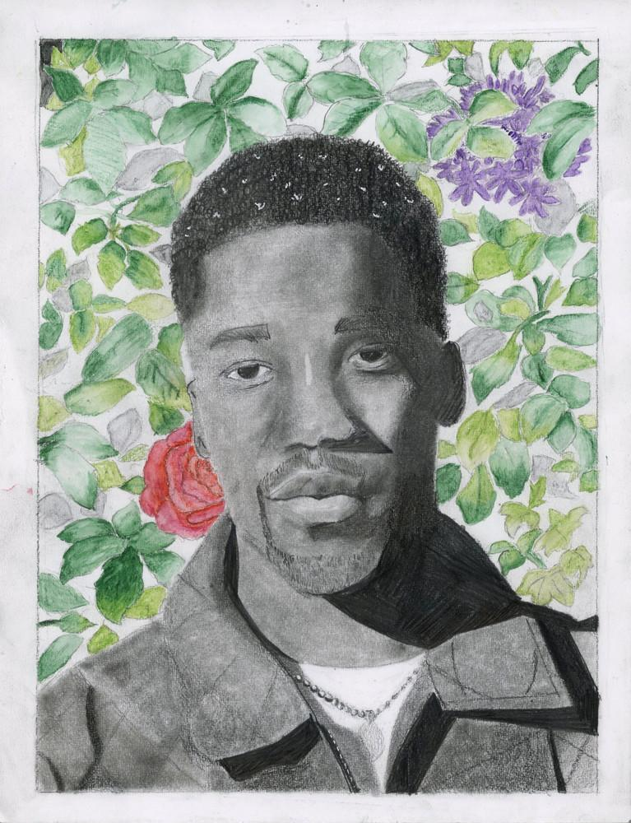
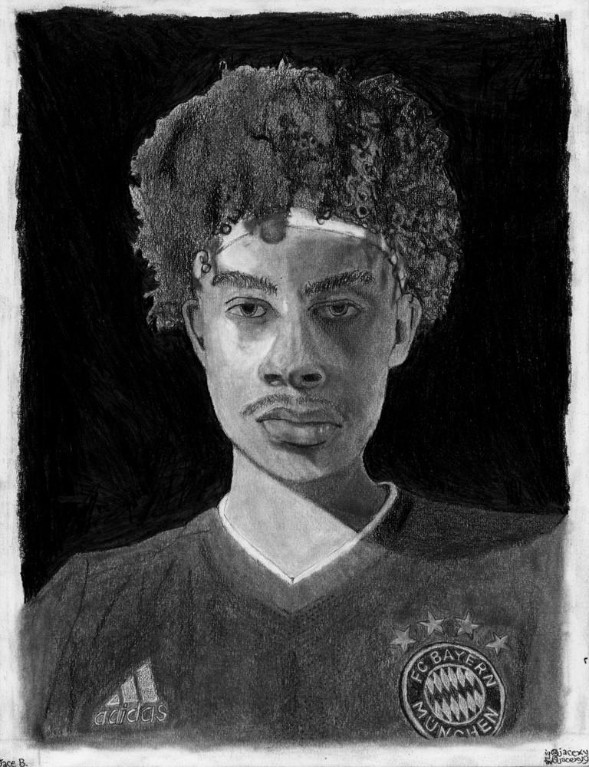
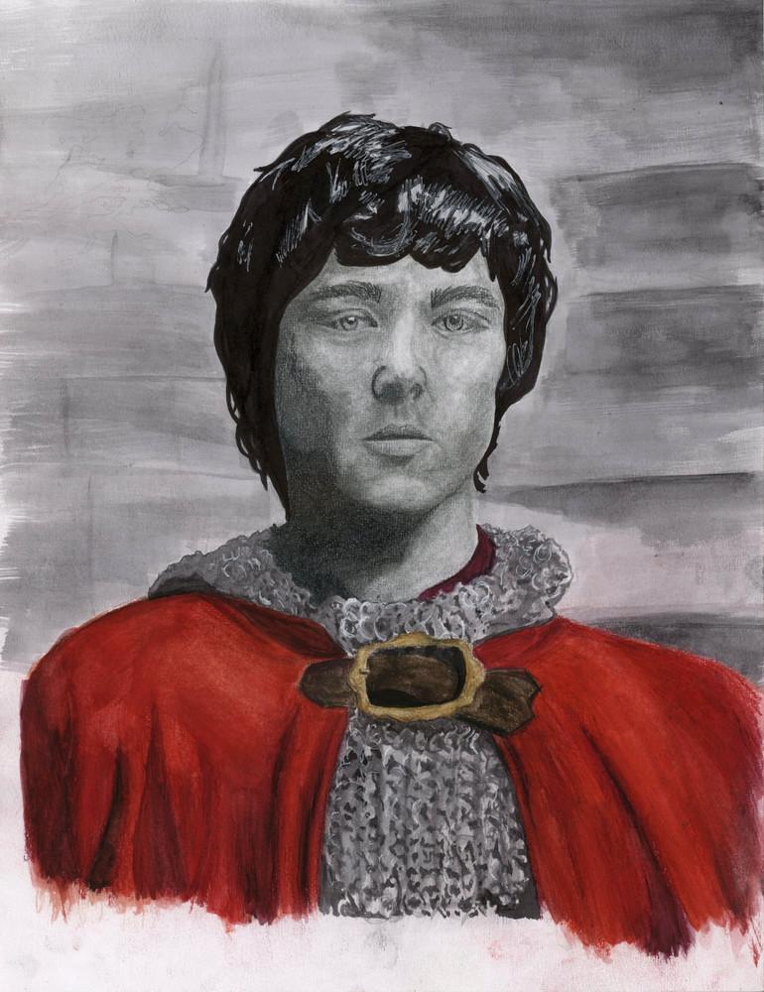
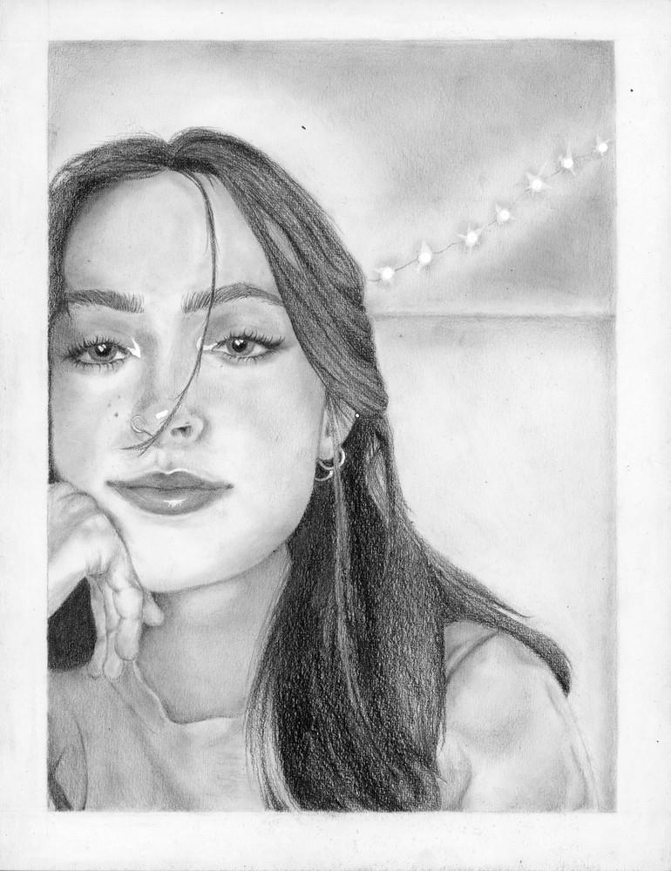
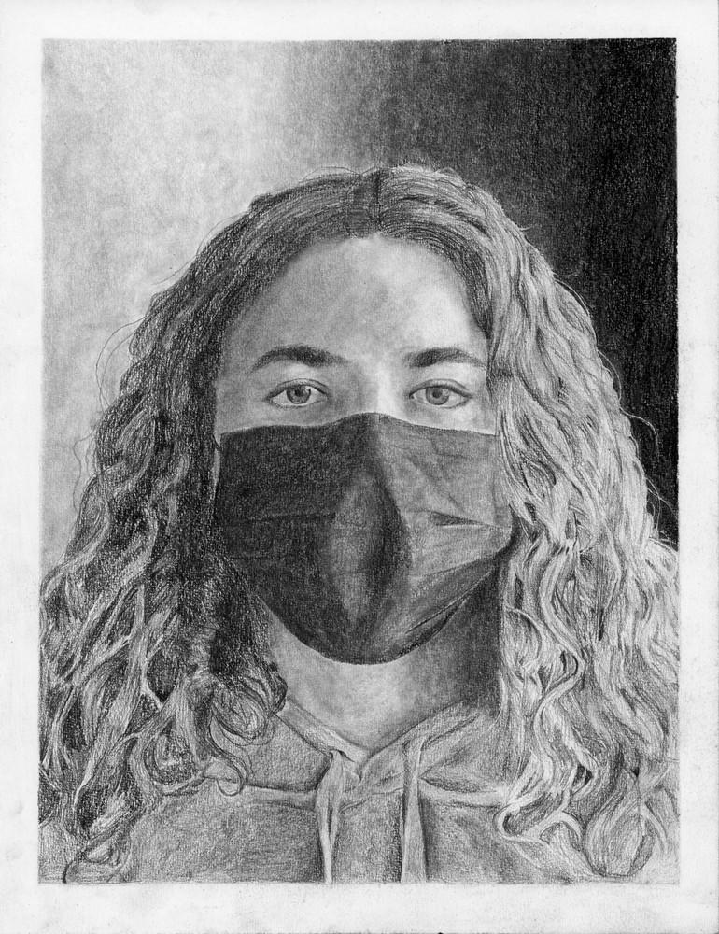
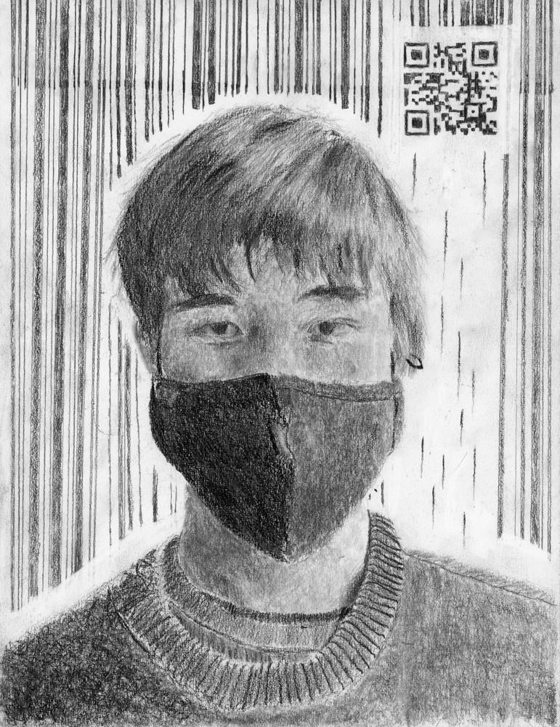
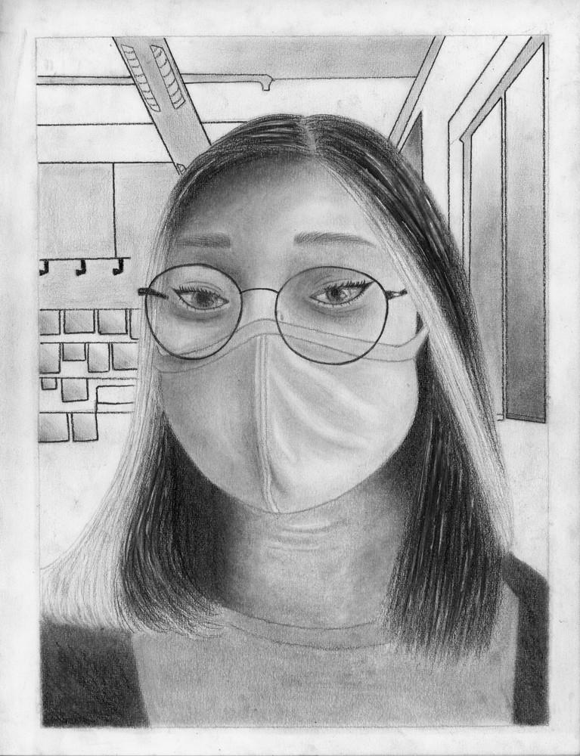

Slide 42
Estel Iscan-Insense
graphite on paper
Spring 2022

Slide 43
Ella Stockley-Smith
graphite on paper
Spring 2022

Slide 44
Etta Jantzen
graphite and watercolour on paper
Spring 2022

Slide 45
Jill Marsman
graphite and watercolour pencil on paper
Spring 2022

Slide 46
Jace Barrett
graphite on paper
Spring 2022

Slide 47
Ray Cleary
graphite and watercolour pencil on paper
Spring 2022

Slide 48
Nate
Olivia Sullivan Newhook
Spring 2022

Slide 49
Jordan Daigle
graphite on paper
Spring 2022

Slide 50
Joe Petrash
graphite on paper
Spring 2022

Slide 51
Momiji O'Malley
graphite on paper
Spring 2022

Slide 53
13

Slide 54
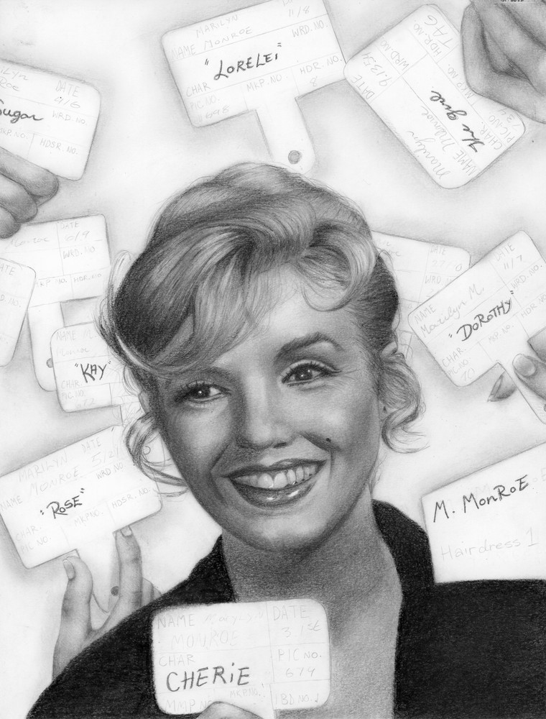
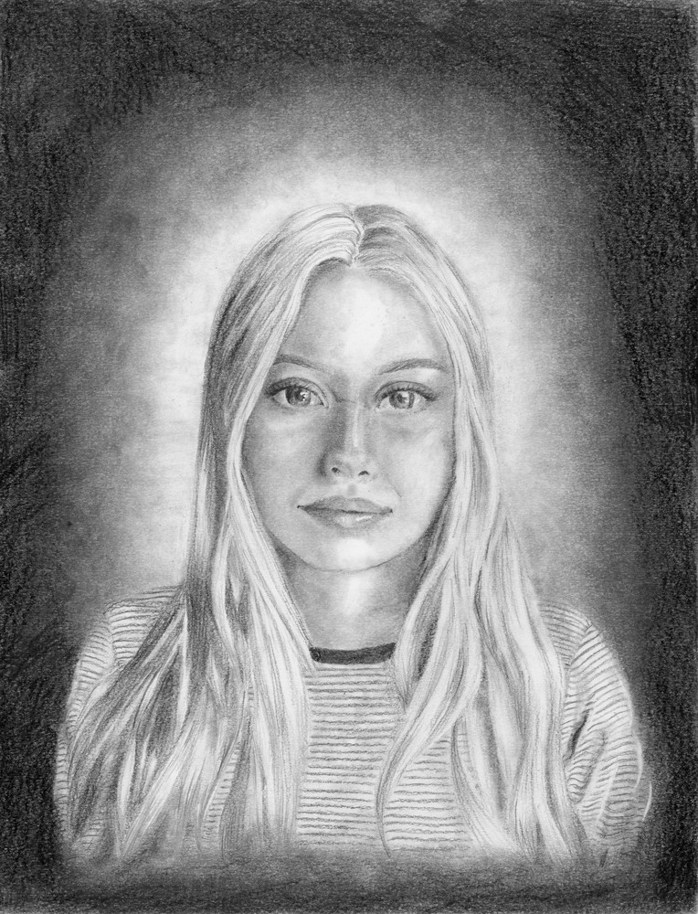
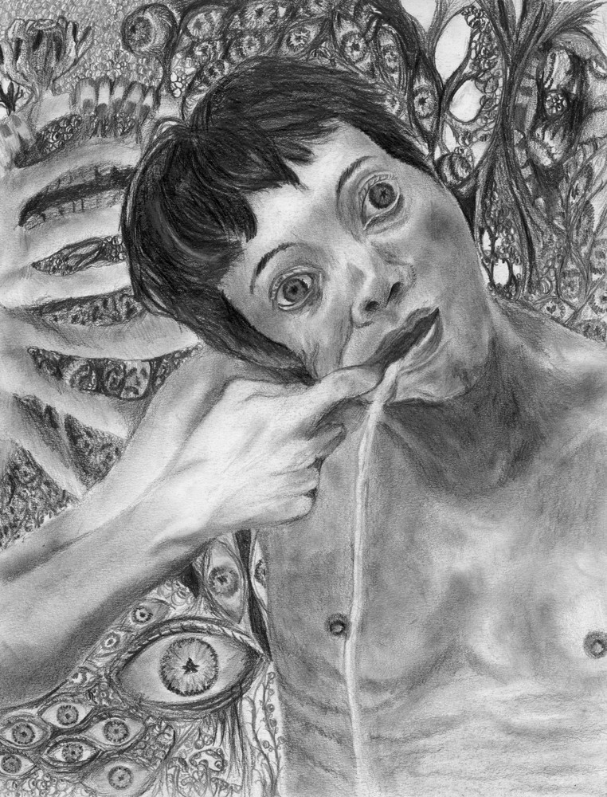
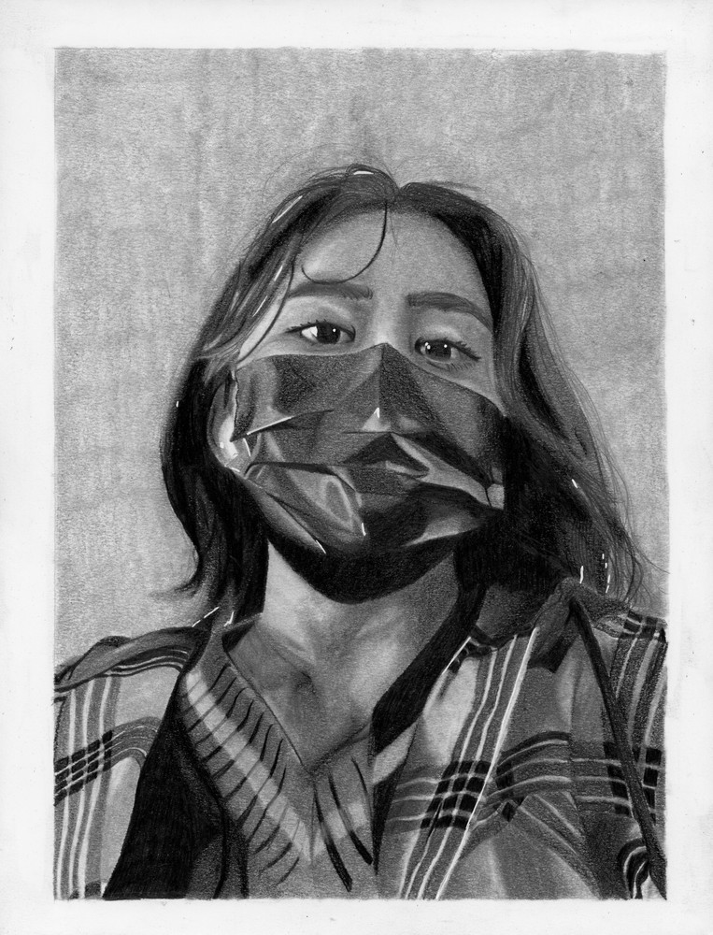
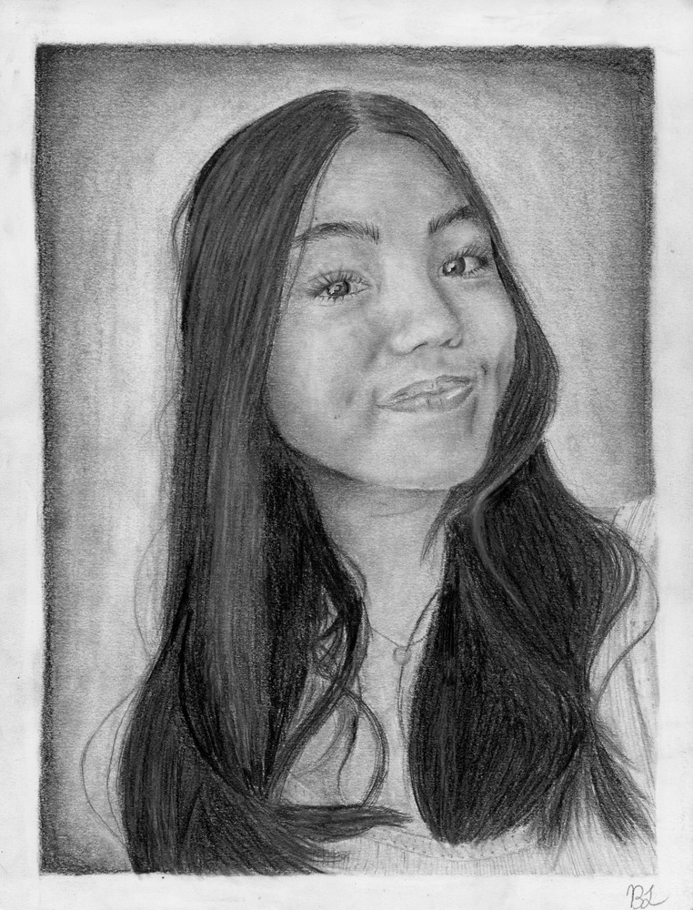
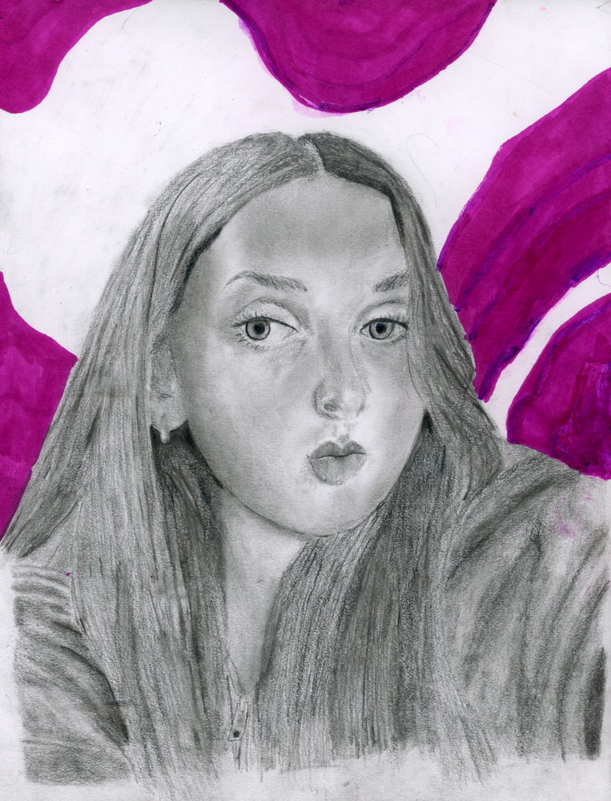

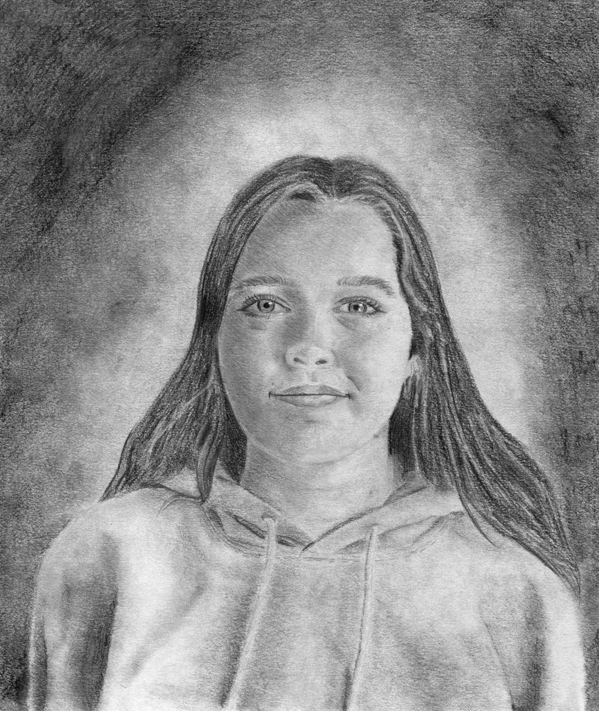

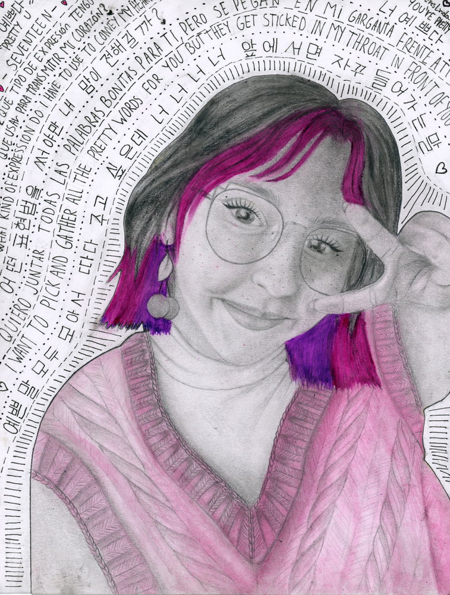

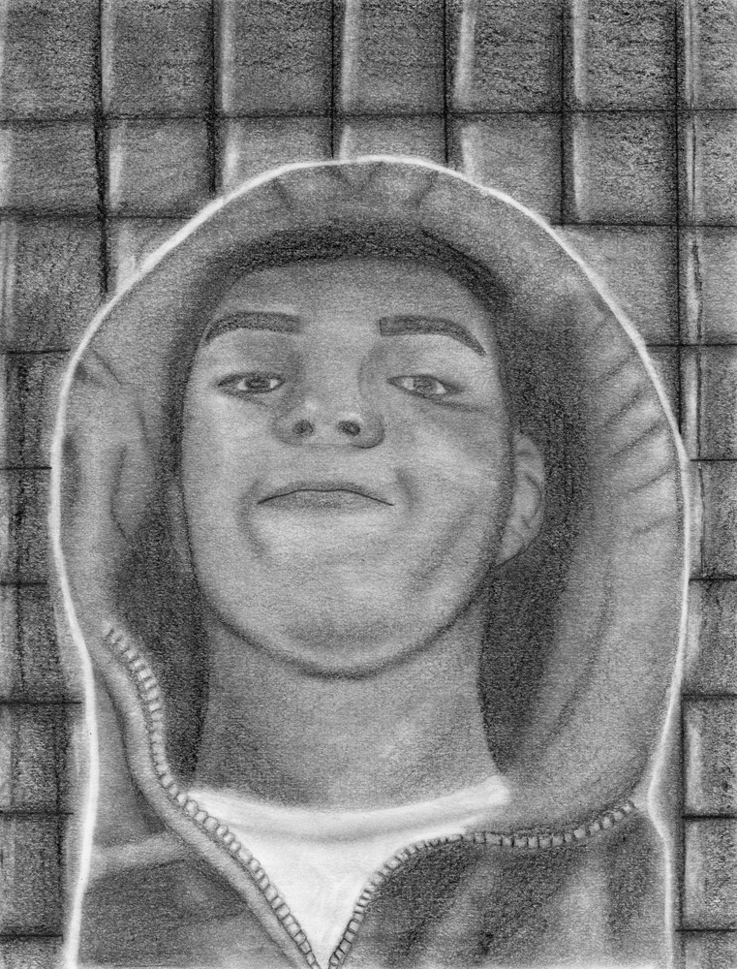

Slide 55
anonymous
graphite on paper
Fall 2022
Citadel Creates
@mrdrapak

Slide 56
Alice Curry
graphite on paper
Fall 2022
Citadel Creates
@mrdrapak

Slide 57
Aresky Novelo Espinosa
graphite on paper
Fall 2022
Citadel Creates
@mrdrapak

Slide 58
Ashanti Sarmiento
graphite on paper
Fall 2022
Citadel Creates
@mrdrapak

Slide 59
Brigid Libadia
graphite on paper
Fall 2022
Citadel Creates
@mrdrapak

Slide 60
Brooke Howes
graphite on paper
Fall 2022
Citadel Creates
@mrdrapak

Slide 61
Drew Gooding
graphite on paper
Fall 2022
Citadel Creates
@mrdrapak

Slide 62
Erin Keaveny
graphite on paper
Fall 2022
Citadel Creates
@mrdrapak

Slide 63
Erin Kells
graphite on paper
Fall 2022
Citadel Creates
@mrdrapak

Slide 64
Josefa Hernandez Ureta
graphite and watercolour on paper
Fall 2022
Citadel Creates
@mrdrapak

Slide 65
Leelah Makhoul
graphite on paper
Fall 2022
Citadel Creates
@mrdrapak

Slide 66
Mila Fredericks
graphite on paper
Fall 2022
Citadel Creates
@mrdrapak

Slide 68
14

Slide 69
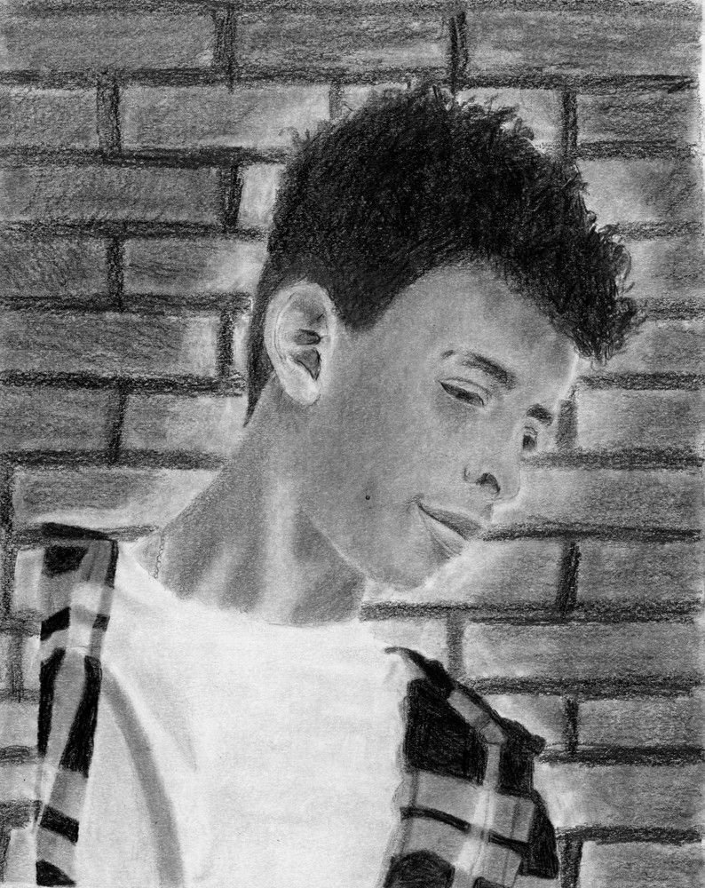
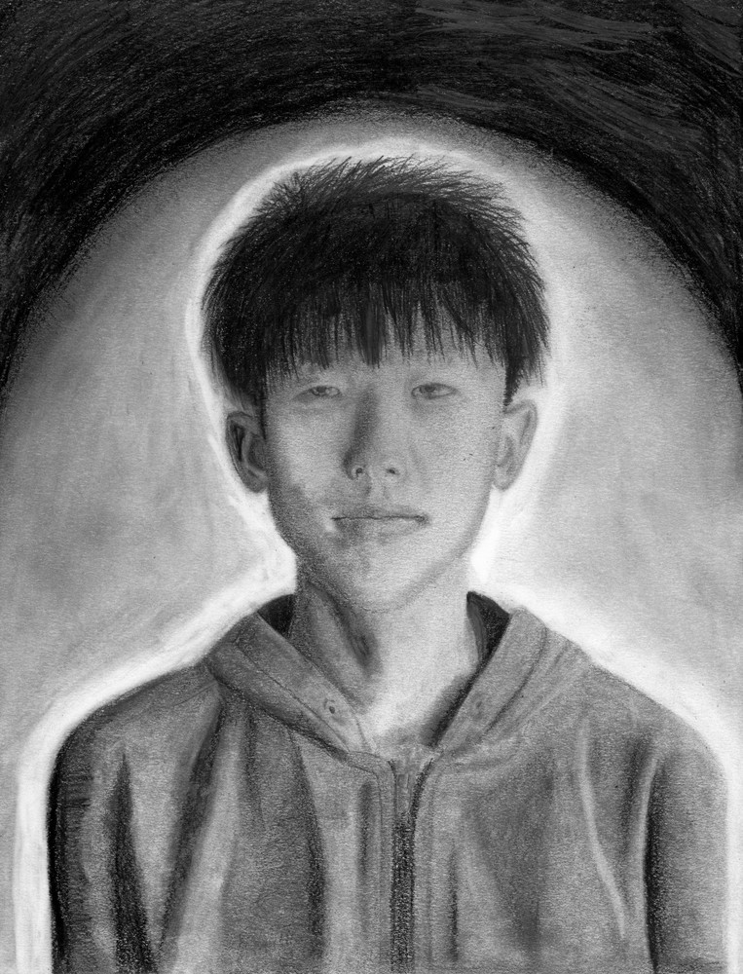











Slide 70
Mostafa Mahmoud
graphite on paper
Fall 2022
Citadel Creates
@mrdrapak

Slide 71

Navon Situ
graphite on paper
Fall 2022
Citadel Creates
@mrdrapak

Slide 72
Parker Smith
graphite on paper
Fall 2022
Citadel Creates
@mrdrapak

Slide 73
Parvathi Edicherry
graphite on paper
Fall 2022
Citadel Creates
@mrdrapak

Slide 74
Sadie Buxton, graphite and watercolour on paper, Fall 2022

Slide 75
SaKoda Colley
graphite on paper
Fall 2022
Citadel Creates
@mrdrapak

Slide 76
Sarah Lou
graphite on paper
Fall 2022
Citadel Creates
@mrdrapak

Slide 77
Silas Armstrong
graphite and stenciled paper on paper
Fall 2022
Citadel Creates
@mrdrapak

Slide 78
Tyler Lafitte
graphite on paper
Fall 2022
Citadel Creates
@mrdrapak

Slide 79
Yosr Fadhel
graphite on paper
Fall 2022
Citadel Creates
@mrdrapak

Slide 80
Zane Brown, graphite on paper, Fall 2022

Slide 81
Zoe Radford
graphite on paper
Fall 2022
Citadel Creates
@mrdrapak

Slide 83
15

Slide 84













Slide 85
Bixy Berry
graphite and coloured pencil on paper
Spring 2023
Lockview High School
Ms. Tasker

Slide 86
Savannah Comeau
graphite and coloured pencil on paper
Spring 2023
Sackville High School
@shsartwest

Slide 87
Elle Langley
graphite on paper
Spring 2023
Citadel Creates
@mrdrapak

Slide 88
Leah McGrath
graphite on paper
Spring 2023
Citadel Creates
@mrdrapak

Slide 89
Abby DeWolfe
graphite on paper
Spring 2023
Citadel Creates
@mrdrapak

Slide 90
Sophia Falle
graphite and marker on paper
Spring 2023
Citadel Creates
@mrdrapak

Slide 91
Reid Gillis
graphite on paper
Spring 2023
Citadel Creates
@mrdrapak

Slide 92
Nevaeh Grant, graphite and watercolour on paper, Spring 2023
Lockview High School, Ms. Tasker

Slide 93
Izzy Hussey
graphite and thread on paper
Spring 2023
Citadel Creates
@mrdrapak

Slide 94
Johnylah James
graphite on paper
Spring 2023
Citadel Creates
@mrdrapak

Slide 95
Jiah Kim
graphite on paper
Spring 2023
Citadel Creates
@mrdrapak

Slide 96
Lucas Lai
graphite on paper
Spring 2023
Citadel Creates
@mrdrapak

Slide 98
16

Slide 99













Slide 100
Kieran Gale
graphite on paper
Spring 2023
Lockview High School
Ms. Tasker

Slide 101
Avery Comeau
graphite and coloured pencil on paper
Spring 2023
Lockview High School
Ms. Tasker

Slide 102
Alexa Maillet
graphite on paper
Spring 2023
Sackville High School
@shsartwest

Slide 103
Louisa Morris
graphite on paper
Spring 2023
Citadel Creates
@mrdrapak

Slide 104
Annie Patel
graphite on paper
Spring 2023
Citadel Creates
@mrdrapak

Slide 105
Mica Paul
graphite on paper
Spring 2023
Citadel Creates
@mrdrapak

Slide 106
Max Seale
graphite on paper
Spring 2023
Citadel Creates
@mrdrapak

Slide 107
Kokheb Tesfatsion
graphite on paper
Spring 2023
Citadel Creates
@mrdrapak

Slide 108
North Wright
graphite on paper
Spring 2023
Citadel Creates
@mrdrapak

Slide 109
Razan Izeldin
graphite on paper
Spring 2023
Citadel Creates
@mrdrapak

Slide 110
Shiang Liu
graphite on paper
Spring 2023
Citadel Creates
@mrdrapak

Slide 111
Una Liu
Graphite, gouache, and glitter glue on paper
Spring 2023
Citadel Creates
@mrdrapak

Slide 113
Fall 2023 - 16

Slide 114














Slide 115
Quincey Johnston
graphite and coloured pencil on paper
Fall 2023

Slide 116
Ash Harper
graphite on paper
Fall 2023
Sackville High School
@shsartwest

Slide 117
Kabir Kumar
graphite on paper
Fall 2023

Slide 118
Matt Inkpen
graphite and watercolour on paper
Fall 2023

Slide 119
Lily Campbell
graphite on paper
Fall 2023

Slide 120
Ben Phillips
Graphite and pastel on paper
Fall 2023
Lockview High School
Ms. Tasker

Slide 121
Xintang Wang
graphite and coloured pencil on paper
Fall 2023

Slide 122
Mariah Wentzell
graphite on paper
Fall 2023
Lockview High School
Ms. Tasker

Slide 123
Emily Bickerton, graphite on paper, Fall 2023
Lockview High School, Ms. Tasker

Slide 124
Mya Rimmer
graphite on paper
Fall 2023

Slide 125
Cami Raquet
graphite on paper
Fall 2023
Sackville High School
@shsartwest

Slide 126
Lisa Khutjwe
graphite and marker on paper
Fall 2023

Slide 127
Arik Arik
graphite and coloured pencil on paper
Fall 2023
Sackville High School
@shsartwest

Slide 129
Fall 2023 - 17

Slide 130















Slide 131
Gaelle Bousquet
graphite and coloured pencil on paper
Fall 2023

Slide 132
Mya Honey, graphite on paper, Fall 2023
Sackville High School @shsartwest

Slide 133
Fatma Yaman
graphite on paper
Fall 2023

Slide 134
Chloe Snair
graphite and acrylic on paper
Fall 2023
Sackville High School
@shsartwest

Slide 135
Olivia Woodill
graphite on paper
Fall 2023
Lockview High School
Ms. Tasker

Slide 136
Ahsan Amir
graphite on paper
Fall 2023

Slide 137
Julija Bowman
graphite on paper
Fall 2023

Slide 138
Zoey Berezowski
graphite and watercolour on paper
Fall 2023
Lockview High School
Ms. Tasker

Slide 139
Lexi Reed
graphite and watercolour on paper
Fall 2023
Sackville High School
@shsartwest

Slide 140
Felix Harpur
graphite on paper
Fall 2023

Slide 141
Andel Brown
graphite and coloured pencil on paper
Fall 2023

Slide 142
Chloe Taylor
graphite and watercolour on paper
Fall 2023
Sackville High School
@shsartwest

Slide 143
Sophia Rogers
graphite on paper
Fall 2023
Lockview High School
Ms. Tasker

Slide 144
Carter Jecks
graphite on paper
Fall 2023
Lockview High School
Ms. Tasker

Slide 147
Spring 2024a 18

Slide 148















Slide 149
Jack Buckman
graphite on paper
Spring 2024
Sackville High

Slide 150
Darnell Upshaw
graphite on paper
Spring 2024
Sackville High

Slide 151
Lara Calder, graphite on paper, Spring 2024 at Lockview High

Slide 152
Nora Sutherland
graphite on paper
Spring 2024
Lockview High

Slide 153
Catherine Fraser
graphite on paper
Spring 2024
Citadel High

Slide 154
Scarlett Reynolds
graphite on paper
Spring 2024
Citadel High

Slide 155
Opemipo Ajetomobi
graphite on paper
Spring 2024
Citadel High

Slide 156
Anita Izadi, graphite on paper, Spring 2024 at Citadel High

Slide 157
Soul Kim
graphite on paper
Spring 2024
Citadel High

Slide 158
Emma Scott
graphite on paper
Spring 2024
Lockview High

Slide 159
Kate Morgan-MacFadyen
graphite on paper
Spring 2024
Citadel High

Slide 160
Sarthak Gade, graphite on paper, Spring 2024 at Sackville High

Slide 161
Alana Mercier
graphite on paper
Spring 2024
Lockview High

Slide 162
Gabriel Correia
graphite on paper
Spring 2024
Citadel High

Slide 164
Spring 2024b
19

Slide 165














Slide 166
Sasha Kolokolnikov
graphite on paper
Spring 2024
Citadel High

Slide 167
Morgan Marks
graphite on paper
Spring 2024
Lockview High

Slide 168
Alec MacAulay
graphite on paper
Spring 2024
Lockview High

Slide 169
Ella Brimacombe
graphite on paper
Spring 2024
Citadel High

Slide 170
Lena Epstein
graphite on paper
Spring 2024
Citadel High

Slide 171
Andrew Mihai
graphite on paper
Spring 2024
Citadel High

Slide 172
Niwar Sheikh Muslim
graphite on paper
Spring 2024
Citadel High

Slide 173
Jayden Reeves
graphite on paper
Spring 2024
Lockview High

Slide 174
Raquel Khoury
graphite on paper
Spring 2024
Sackville High

Slide 175
Remi Gallant
graphite on paper
Spring 2024
Citadel High

Slide 176
Callum Muise
graphite on paper
Spring 2024
Sackville High

Slide 177
Phoenix Flynn
graphite on paper
Spring 2024
Sackville High

Slide 178
Luke Pelley
graphite on paper
Spring 2024
Sackville High

Slide 180
Fall 2024a
20

Slide 181
















Slide 182
Shreena Sen
graphite on paper
Fall 2024
Citadel High

Slide 183
Riyona Christy
graphite and marker on paper
Fall 2024
Citadel High

Slide 184
Zachary Dufour
graphite on paper
Fall 2024
Sackville High

Slide 185
Neve McGrath
graphite on paper
Fall 2024
Citadel High

Slide 186
Natalie Bent
graphite on paper
Fall 2024
Citadel High

Slide 187
Sydney DeMings
graphite on paper
Fall 2024
Lockview High

Slide 188
Liam Carney
graphite on paper
Fall 2024
Sackville High

Slide 189
Kauthar Green
graphite on paper
Fall 2024
Citadel High

Slide 190
Ana Mihai
graphite on paper
Fall 2024
Lockview High

Slide 191
Elise Twyne
graphite on paper
Fall 2024
Sackville High

Slide 192
Greta McLaren
graphite on paper
Fall 2024
Lockview High

Slide 193
Akiyrah Stevenson
graphite on paper
Fall 2024
Citadel High

Slide 194
Ariel Zou
graphite on paper
Fall 2024
Citadel High

Slide 195
Yvette Lai, graphite on paper, Fall 2024 at Lockview High

Slide 196
Nika Krushko
graphite on paper
Fall 2024
Sackville High

Slide 198
Fall 2024b
21

Slide 199
















Slide 200
Anderson Cole
graphite on paper
Fall 2024
Sackville High

Slide 201
Ryleigh Pardy
graphite on paper
Fall 2024
Sackville High

Slide 202
Eli Webber, graphite on paper, Fall 2024 at Lockview High

Slide 203
Libby Oram
graphite on paper
Fall 2024
Citadel High

Slide 204
Ronan Surette
graphite on paper
Fall 2024
Lockview High

Slide 205
Rebecca Cox
graphite on paper
Fall 2024
Citadel High

Slide 206
Usman Arifov
graphite on paper
Fall 2024
Citadel High

Slide 207
William McLeod
graphite on paper
Fall 2024
Sackville High

Slide 208
Emmett Skanes
graphite on paper
Fall 2024
Citadel High

Slide 209
Kyrylo Klen
graphite on paper
Fall 2024
Lockview High

Slide 210
Emma Savoie
graphite on paper
Fall 2024
Citadel High

Slide 211
Leeluu Derouchie
graphite on paper
Fall 2024
Citadel High

Slide 212
Lydia Marryatt
graphite and watercolour on paper
Fall 2024
Citadel High

Slide 213
Brady Nielsen
graphite on paper
Fall 2024
Sackville High

Slide 223
Spring 2025a
22

Slide 224
















Slide 225
Sarah Martin
graphite on paper
Spring 2025
Sackville High

Slide 226
Leo Hilewitz
graphite on paper
Spring 2025
Citadel High

Slide 227
Gavin Black
graphite on paper
Spring 2025
Sackville High

Slide 228
Lily Crooks
graphite on paper
Spring 2025
Citadel High

Slide 229
Ruby Hilewitz
graphite and coloured pencil on paper
Spring 2025
Citadel High

Slide 230
Rowan Pottie
graphite on paper
Spring 2025
Sackville High

Slide 231
Esja Nener
graphite on paper
Spring 2025
Citadel High

Slide 232
Sophie MacDonald
graphite on paper
Spring 2025
Sackville High

Slide 233
Isla Dove
graphite on paper
Spring 2025
Sackville High

Slide 234
Thalia Loomer
graphite on paper
Spring 2025
Citadel High

Slide 235
Mischaela Wong
graphite on paper
Spring 2025
Citadel High

Slide 236
Andrea Castillo
graphite on paper
Spring 2025
Citadel High

Slide 237
Nathan Parks, graphite on paper, Spring 2025 at Lockview High

Slide 238
Isabelle Christie
graphite on paper
Spring 2025
Lockview High

Slide 239
Cecilia Nguyen
graphite on paper
Spring 2025
Citadel High

Slide 241
Spring 2025b
23

Slide 242
















Slide 243
Julia Hann
graphite on paper
Spring 2025
Lockview High

Slide 244
Kaylie Gray
graphite on paper
Spring 2025
Sackville High

Slide 245
Chloe Montreuil, graphite on paper, Spring 2025 at Citadel High

Slide 246
Dhuha Mohamed
graphite on paper
Spring 2025
Citadel High

Slide 247
Elliot Valiant
graphite on paper
Spring 2025
Lockview High

Slide 248
Aster Wranik-Friedrich
graphite on paper
Spring 2025
Citadel High

Slide 249
Eddie Stanhope
graphite on paper
Spring 2025
Citadel High

Slide 250
Hana Jeong, graphite on paper, Spring 2025 at Citadel High

Slide 251
Isaiah Taranza
graphite on paper
Spring 2025
Citadel High

Slide 252
Chris-Ann Richards
graphite on paper
Spring 2025
Citadel High

Slide 253
Stephanie Connor
graphite and coloured pencil on paper
Spring 2025
Citadel High

Slide 254
Ted Stevens
graphite on paper
Spring 2025
Lockview High

Slide 255
Chase Taplin, graphite on paper, Spring 2025 at Citadel High

Slide 256
Youssef Mohamed
graphite on paper
Spring 2025
Citadel High

Slide 257
Yohana Tedla
graphite on paper
Spring 2025
Sackville High

Slide 260
















Slide 261
Jaiyla Slaunwhite
graphite on paper
Fall 2025
Citadel High

Slide 262
Max Sulewski
graphite on paper
Fall 2025
Citadel High

Slide 263
Matina Kyriakakos
graphite on paper
Fall 2025
Citadel High

Slide 264
Huda Elkord
graphite on paper
Fall 2025
Citadel High

Slide 265
Oliver Rutherford, graphite on paper, Fall 2025 at Citadel High

Slide 266
Jackson Doncaster
graphite on paper
Fall 2025
Sackville High

Slide 267
George Nickerson
graphite on paper
Fall 2025
Citadel High

Slide 268
Eric Earle
graphite on paper
Fall 2025
Citadel High

Slide 269
Tinevimbo Makura
graphite on paper
Fall 2025
Citadel High

Slide 270
Kylee Marryatt, graphite on paper, Fall 2025 at Sackville High

Slide 271
Ryan Rice
graphite on paper
Fall 2025
Citadel High

Slide 272
Kateryna Bilash, graphite on paper, Fall 2025 at Sackville High

Slide 273
Gabe Chuppa
graphite on paper
Fall 2025
Sackville High

Slide 274
Covenant Bassey
graphite on paper
Fall 2025
Citadel High

Slide 275
Sam Gomez
graphite on paper
Fall 2025
Citadel High

Slide 278
















Slide 279
Chloe Willett, graphite on paper, Fall 2025 at Sackville High

Slide 280
Jurni Robinson
graphite on paper
Fall 2025
Citadel High

Slide 281
Libby Lim
graphite on paper
Fall 2025
Citadel High

Slide 282
Cohen Demers
graphite on paper
Fall 2025
Citadel High

Slide 283
Lochie Forde
graphite on paper
Fall 2025
Citadel High

Slide 284
Maddie Thompson
graphite on paper
Fall 2025
Sackville High

Slide 285
Matthew Mackey
graphite on paper
Fall 2025
Sackville High

Slide 286
Advait Abhilash
graphite on paper
Fall 2025
Citadel High

Slide 287
Julia Locke
graphite on paper
Fall 2025
Citadel High

Slide 288
Arthur Moulton
graphite on paper
Fall 2025
Citadel High

Slide 289
Stella Mansfield-Borden
graphite on paper
Fall 2025
Citadel High

Slide 290
Adella Finnamore
graphite on paper
Fall 2025
Citadel High

Slide 291
Adele Ritchie
graphite and watercolour on paper
Fall 2025
Citadel High

Slide 292
Justine Parreno
graphite on paper
Fall 2025
Citadel High

Slide 293
Seth Cogswell
graphite on paper
Fall 2025
Citadel High

